Slide 1
DROWSINESS DETECTION
- ASHU VERMA,CHANDAN KUMAR GUPTA,DAKSH KUMAR
MENTOR-ANSHULA GUPTA

Slide 2
WHAT
IS
DROWSINESS???
To develop a nonintrusive system which can detect fatigue of any human and can issue a timely warning
Due to the drowsiness of the employee they are not able to meet the deadlines of the project and can cause an increase in cost to the company.

Slide 3
APPROACHES TO DETECTING DROWSINESS
BEHAVIOURAL PARAMETERS-BASED TECHNIQUES
. PHYSIOLOGICAL PARAMETERS-BASED TECHNIQUES
DIGITAL IMAGE PROCESSING

Slide 4
BEHAVIOURAL PARAMETERS-BASED TECHNIQUES
In this technique eye blinking frequency, head pose, etc. of a person is monitored through a
camera and the person is alerted if any of these drowsiness symptoms are detected.
Analysing the behaviour of the driver based on his/her eye closure ratio, blink frequency, yawning, position of the head and facial expressions.

Slide 5
PHYSIOLOGICAL PARAMETERS-BASED TECHNIQUES
Measuring the drowsiness of the employees based on the physical conditions of the employees fall under this category.
Such parameters may be respiration rate, heart-beat rate, body temperature and many more.

Slide 6
DIGITAL IMAGE PROCESSING
The term digital image processing generally refers to processing of a two- dimensional picture by a digital computer.
3 Types :
Pixel
Digital Image
Gray Level

Slide 7
Parameters for determining the drowsiness
Eye blink
Area of the pupils detected at eyes
Yawning

Slide 8




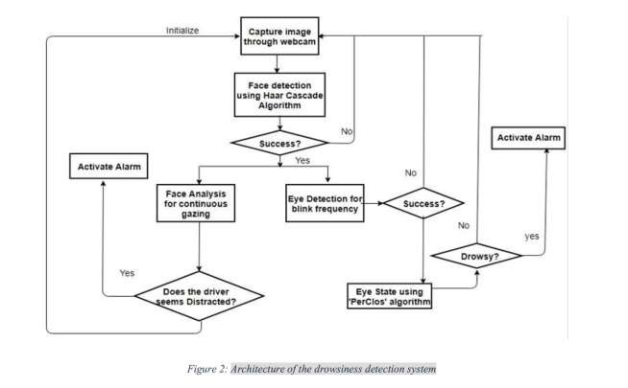

ARCHITECTURE OF THE DROWSINESS DETECTION SYSTEM

Slide 9


Face Detection
Eye Detection
Face Tracking
Eye Tracking
Drowsiness Detection
Distraction Detection
ARCHITECTURE CONSISTS OF 6
MODULES:

Slide 10
Technology Used
Tensor Flow
Open CV
Machine Learning

Slide 11
More Usage Of Drowsiness Detection
Tesla
Self-driving cars
Artificial Intelligence (AI)

Slide 12
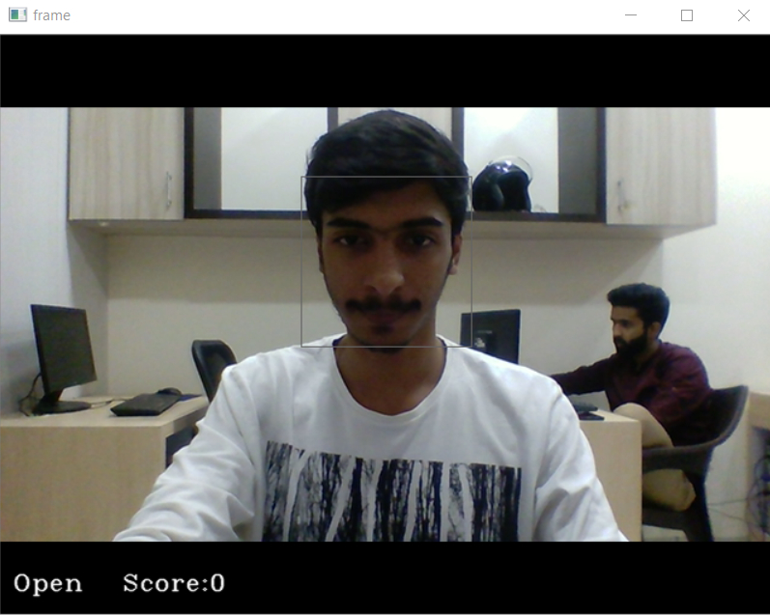
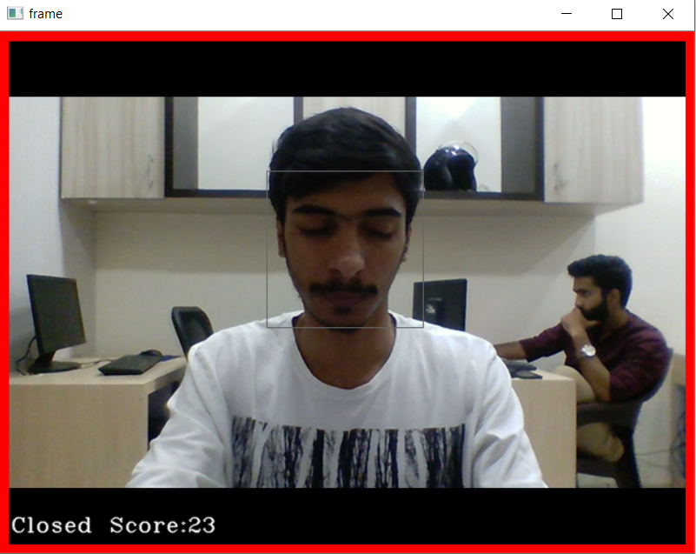
Images For Evaluation

Slide 13

THANK
YOU..!!!

